Slide 1

PLC Theory – Types of PLCs

Slide 2
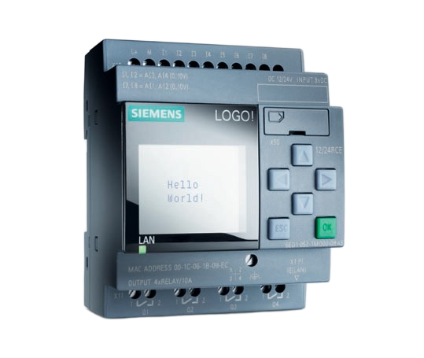
What is a PLC?
  A Programmable Logic Controller, or PLC, is a ruggedized computer used for industrial automation.
  These controllers can automate a specific process, machine function, or even an entire production line.
  It is less powerful than traditional computers

Slide 3
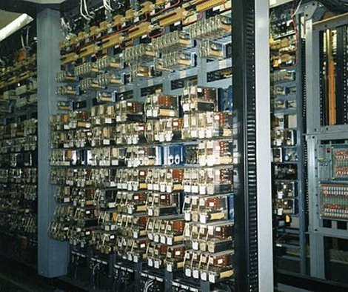
History of PLCs
  Before PLCs were commonplace industrial systems would be controlled by relay control panels
  These controllers used many relays, mechanical switches, times and counters

Slide 4
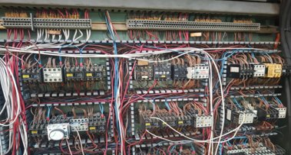
History of PLCs
  The relay control panels took up a lot of space
  They were subject to wear and tear
  There was often wiring issues, and they would take a long time to solve as you had to trace wires
  They were also very time consuming to upgrade
  And upgrading or fixing would mean the shutting down of operation for a period for debugging

Slide 5
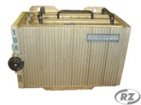
History of PLCs
  In the 1960s General motors identified the requirement of a computer-controlled system
  They highlighted these requirements:
      Solid state not mechanical
      Easily modifiable inputs/outputs
      Ease of programming
      Be able to function in an industrial environment

Slide 6
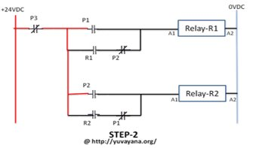
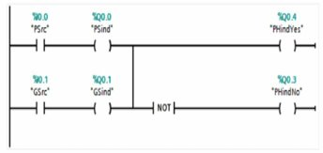
History of PLCs
  They developed a graphical programming language based on Relay Logic Diagrams
  This made the adaptation much easier and meant not a lot of retraining had to be done
  This programming language became known as “Ladder Logic”

Slide 7
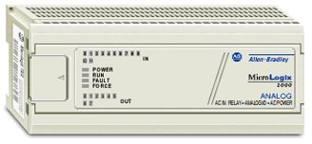
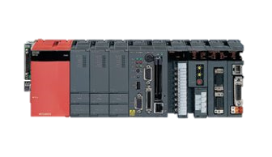
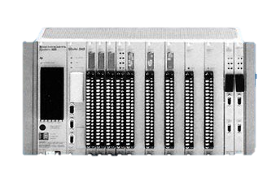
Types of PLCs
  There are several different types if PLCs:
      Unitary
      Modular
      Rack Mounted

Slide 8
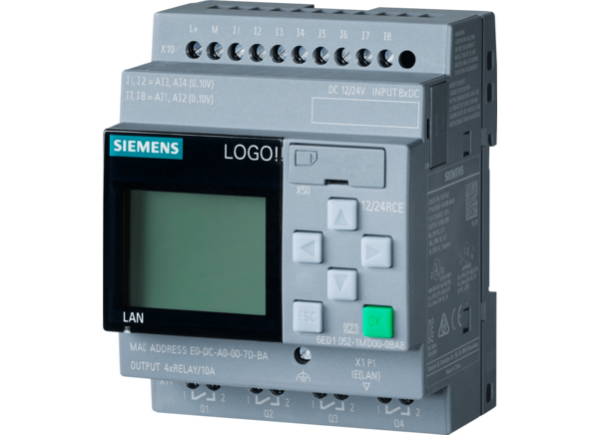
Unitary PLCs
  A compact Programmable Logic Controller (PLC) with all components in a single housing.
  Features
      Built-in processor, power supply, and input/output (I/O) interfaces.
      Typically limited I/O capacity
      Non-expandable – I/O count is fixed.

Slide 9
Unitary PLCs
  Advantages:
      Simple to install and configure.
      Cost-effective for small automation tasks.
      Ideal for space-constrained applications.
  Limitations:
      Not suitable for complex or large-scale systems.
      Limited programming and communication options.

Slide 10
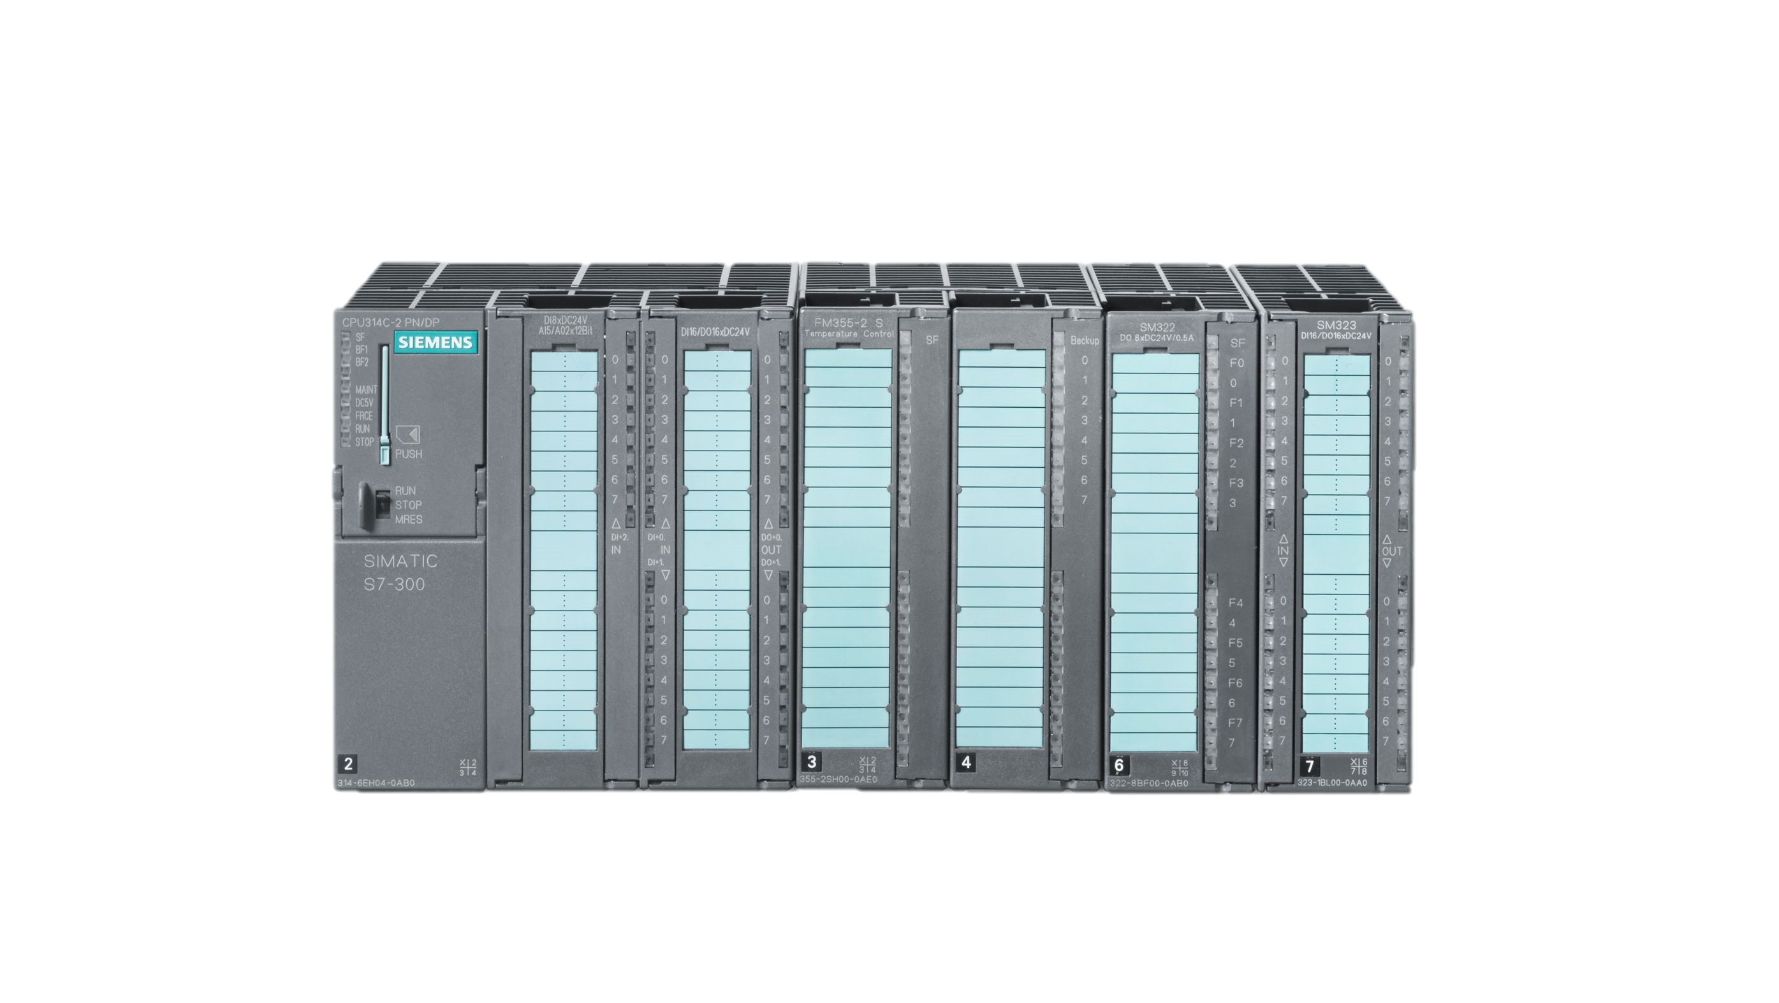
Modular PLCs
  A type of PLC system made up of separate, interchangeable modules (CPU, power supply, I/O, communication, etc.).
  Features
      Expandable I/O – modules can be added as needed.
      Customizable to suit specific applications.
      Typically mounted on a rack or chassis.

Slide 11
Modular PLCs
  Advantages:
      Scalable – suitable for medium to large automation systems.
      Easier maintenance and upgrades (modules can be swapped).
      Supports advanced communication and networking..
  Limitations:
      Higher cost compared to unitary PLCs.
      Requires more installation space and setup time.

Slide 12
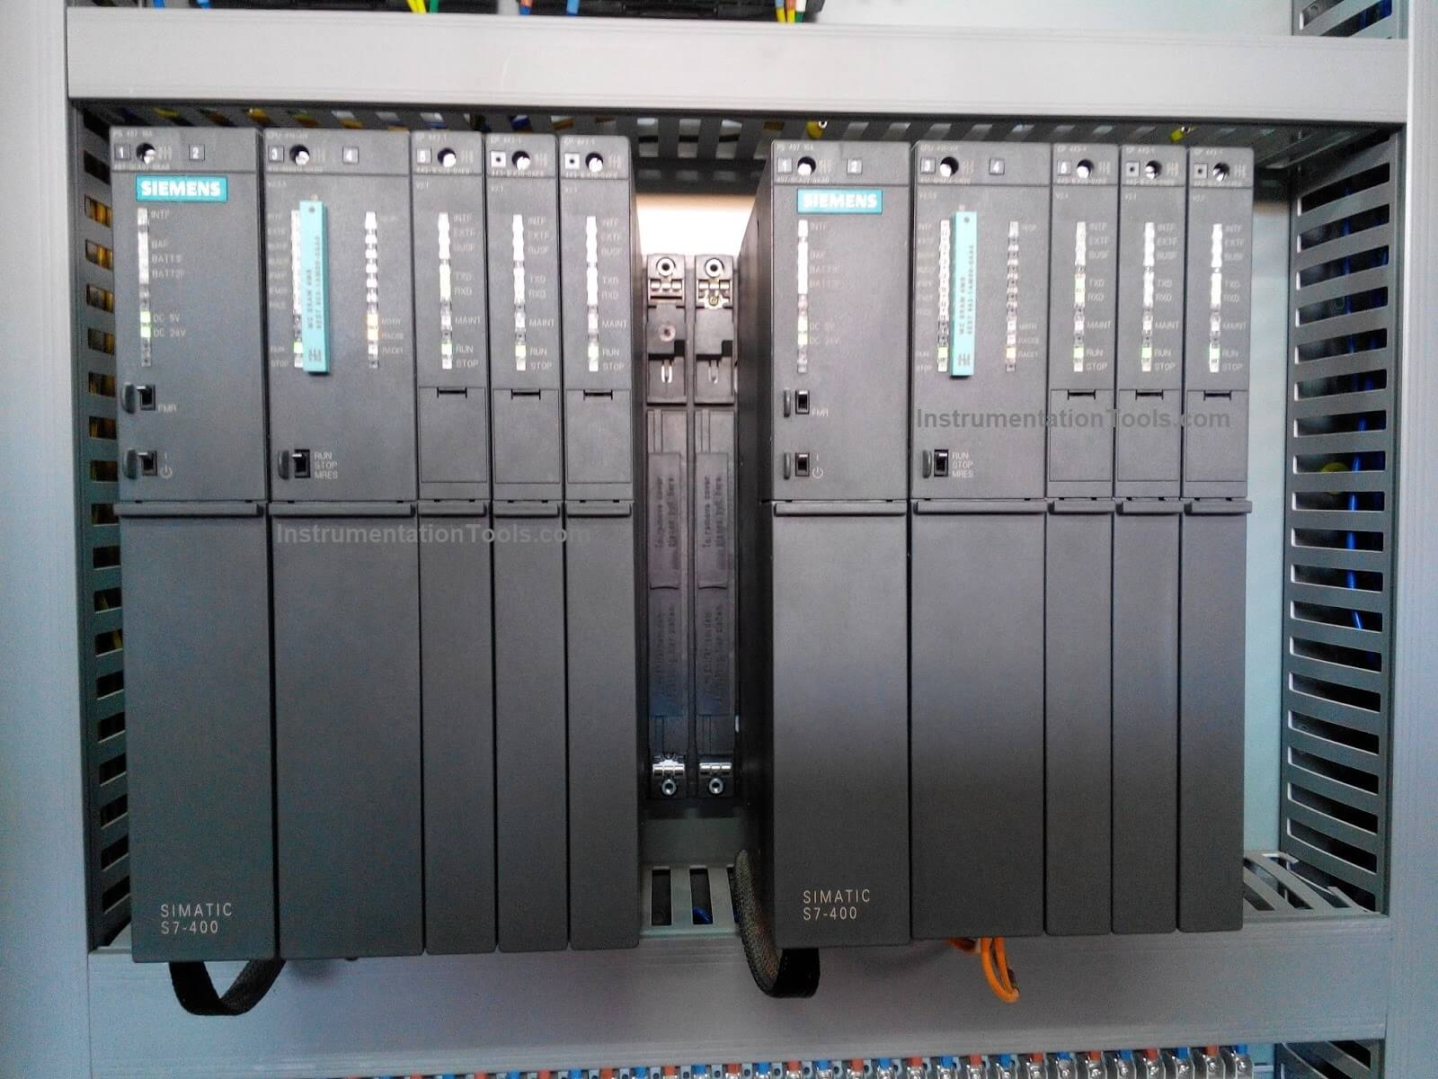
Rack Mounted PLCs
  A type of modular PLC where all modules are mounted into a standardized rack or chassis.
  Features
      Centralized backplane allows modules to communicate and share power/data.
      Supports a wide range of module types (CPU, analog/digital I/O, comms, etc.).
      High-performance and highly customizable.

Slide 13
Rack Mounted PLCs
  Advantages:
      Ideal for large, complex, or mission-critical systems.
      Simplified wiring and module replacement.
      High reliability and robust design.
  Limitations:
      Expensive initial investment.
      Requires significant panel space and skilled installation.

Slide 14
Comparison
Feature | Unitary PLC | Modular PLC | Rack-Mounted PLC
Structure | All-in-one, compact housing | Separate, interchangeable modules | Centralized rack for modules
Expandability | Fixed I/O, no expansion | Expandable by adding modules | Highly expandable with many module options
Installation Space | Small, compact | Moderate space required | Requires significant space for rack and modules
Applications | Small to medium systems | Medium to large systems | Large, complex, and critical systems
Cost | Lower cost, cost-effective for small tasks | Moderate to high cost | High cost, typically used in large installations
Maintenance | Basic maintenance, limited modularity | Easy module replacement and upgrades | Centralized maintenance and module swapping
Typical Use Cases | Simple tasks like lighting control or HVAC | Manufacturing lines, conveyor systems | Power plants, large factory-wide systems

Slide 15
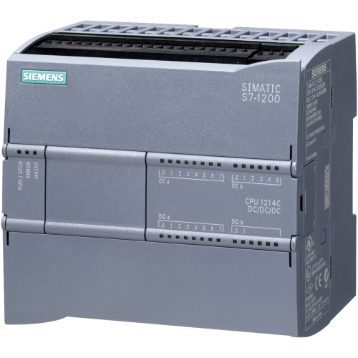
Unitary with Modular Capabilities
  A compact PLC with built-in components that also supports limited expansion through add-on modules.
  Features
      All-in-one base unit (CPU, I/O, power supply).
      Expansion ports or slots for limited I/O or communication modules.
      Often DIN-rail mountable like standard unitary PLCs.

Slide 16
Unitary with Modular Capabilities
  Advantages:
      Maintains compactness while offering some flexibility.
      Cost-effective upgrade path from basic to more advanced control.
      Easier to scale than pure unitary PLCs.
  Limitations:
      Expansion capacity is limited compared to full modular or rack-mounted systems.
      Add-on modules are often proprietary.

Slide 17
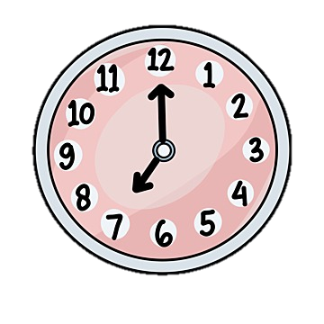



Which PLC to use?
  When deciding which PLC to use for a project we have several considerations:
        PLC speed of operation
        I/O count
        Power requirements
        Communications
        Company standards
        PLC cost
        Versatility

